Slide 1
Adventure works
- Performance insights -
By Group 1

Slide 2
members‍
NIKITHA
AMITH RAJ
VAITHEESWARAN
YAMJALA SREESHANT
RUCHA SIDDHARTH POKALE
DEEPALI RAJKUMAR SUDAKE

Slide 3
introduction
Project Overview
> Multi-tool analytics project covering sales data from Adventure Works
> Data integrated from Fact InternetSales & Fact Internet Sales New (Union)
> Enriched with Product, Customer & Territory lookups
> Spanning years 2010-2014 with 60,000+ order records
Objectives
> Build unified sales dataset with calculated KPIS
> Analyse performance by year, month, quarter & region
> Create interactive dashboards in Excel, Power BI & Tableau
> Deliver actionable insights for management decisions
Dataset Details
> Source: Adventure Works Data Warehouse
> Tables: Fact Sales, Product, Customer, Territory
> Key fields: Order Date, Unit Price, Cost, Quantity
> Calculated: Sales Amount, Production Cost, Profit, Date fields

Slide 4
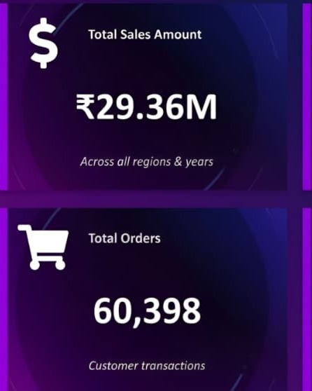
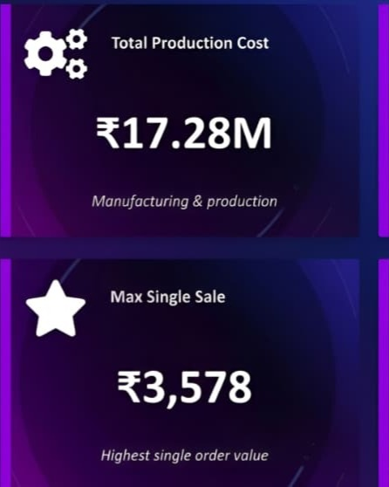
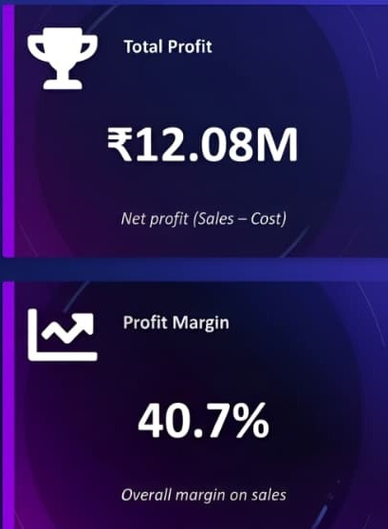
n
KEY PERFORMANCE INDICATORS - OVERVIEW
nnn

Slide 5
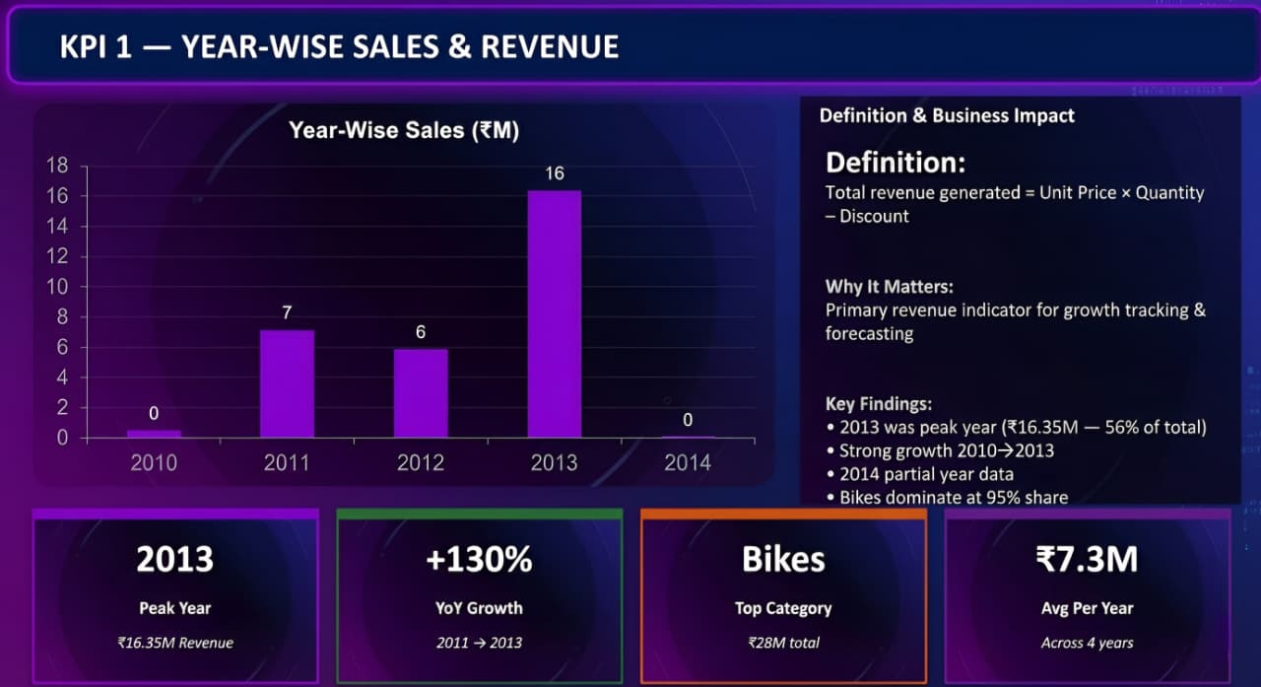

Slide 6
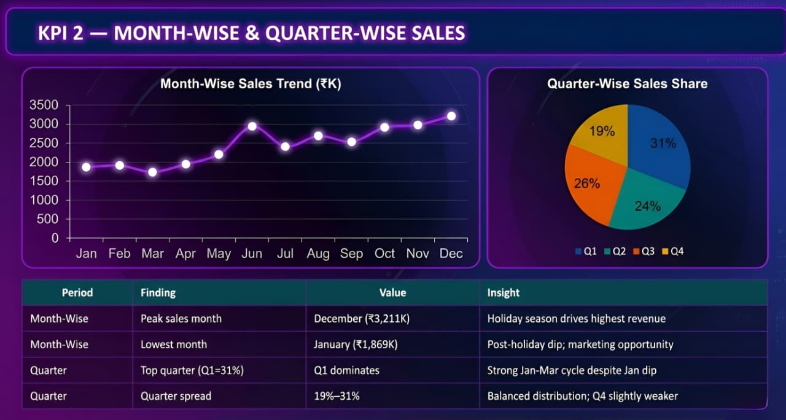

Slide 7
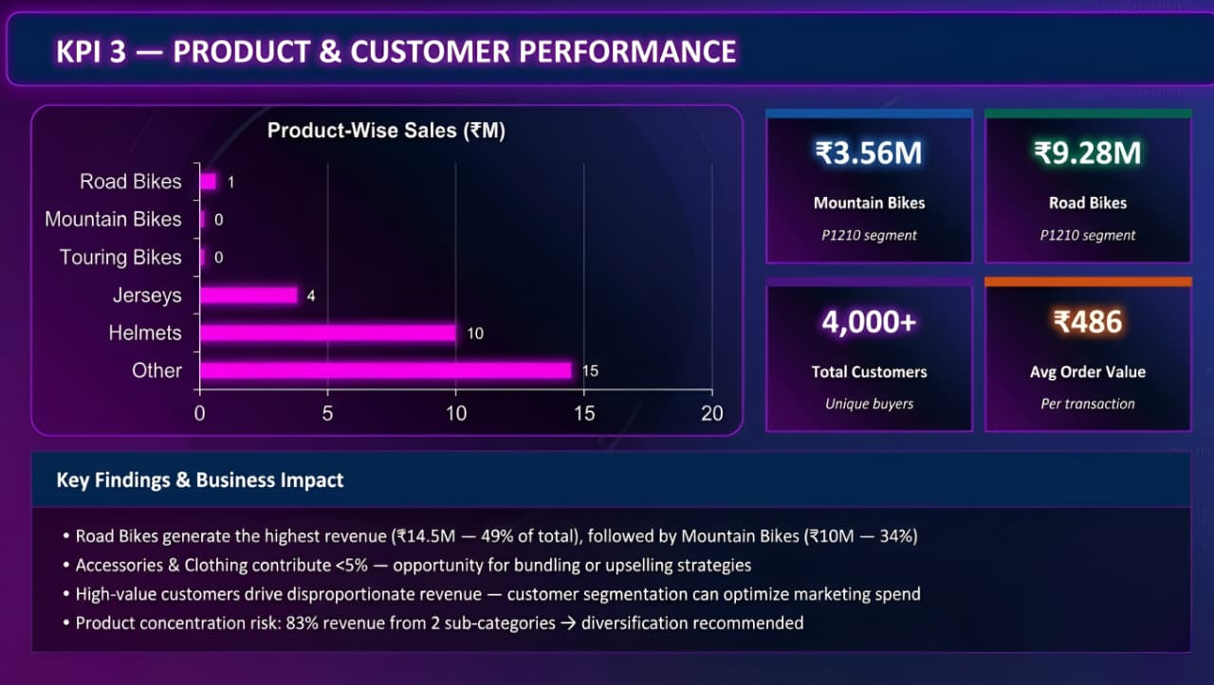

Slide 8
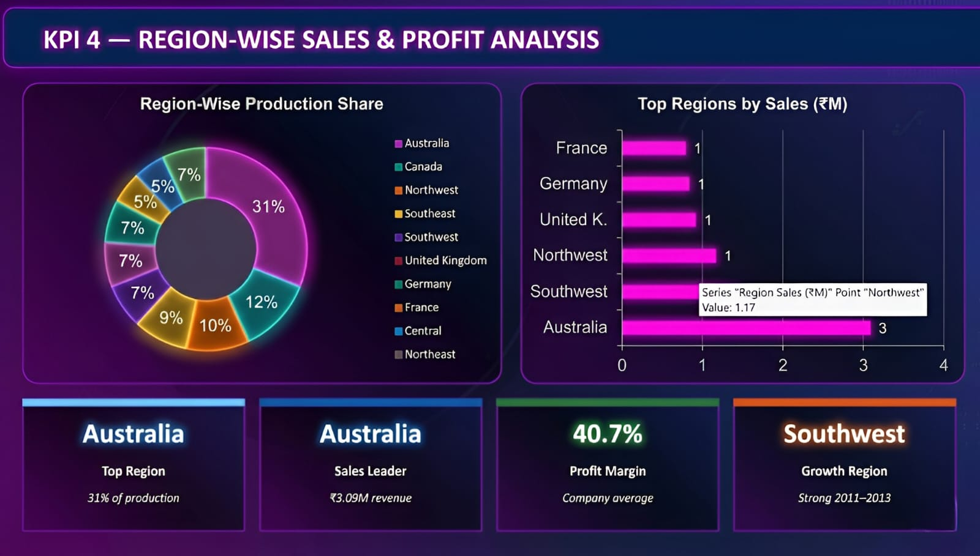

Slide 9
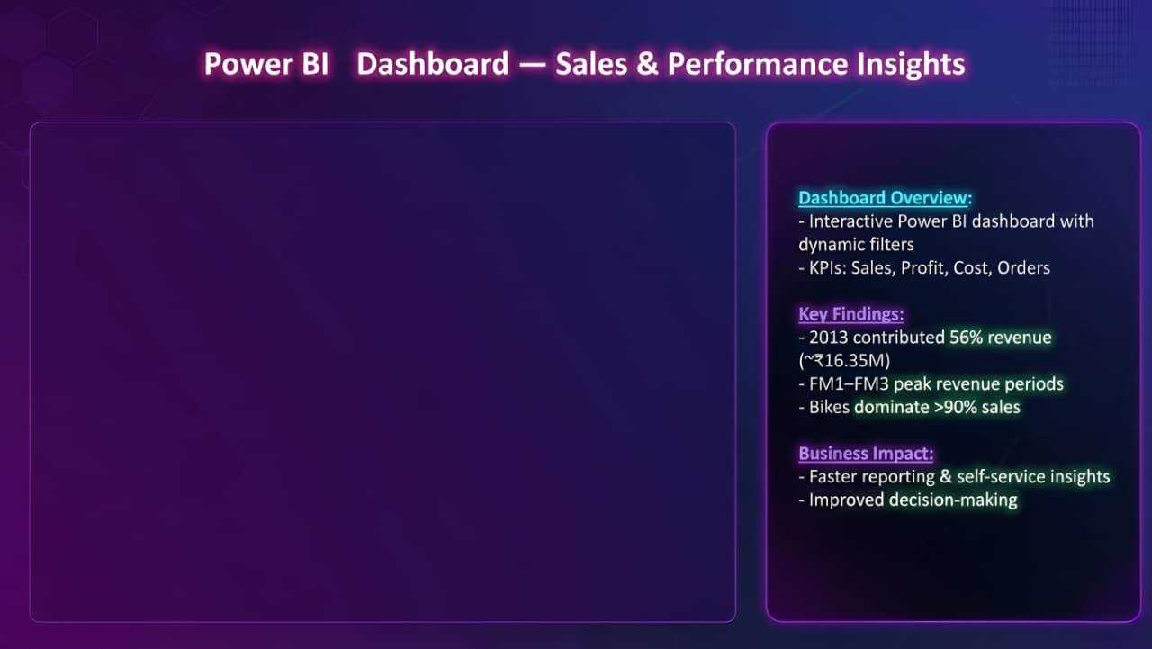
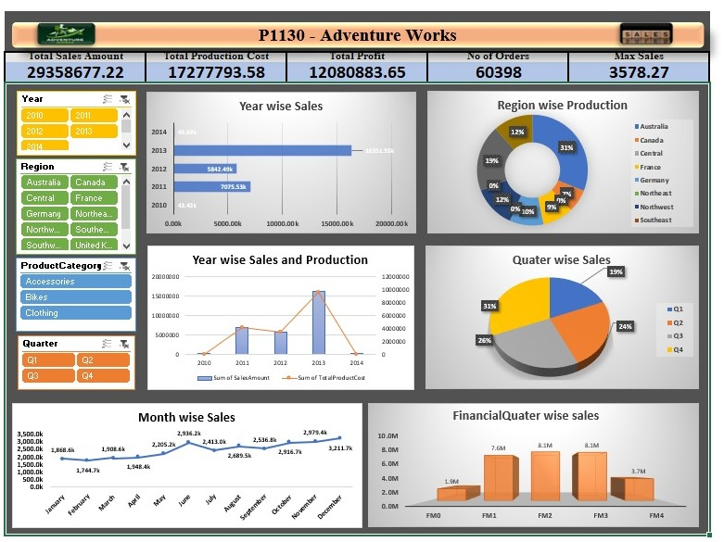

Slide 10
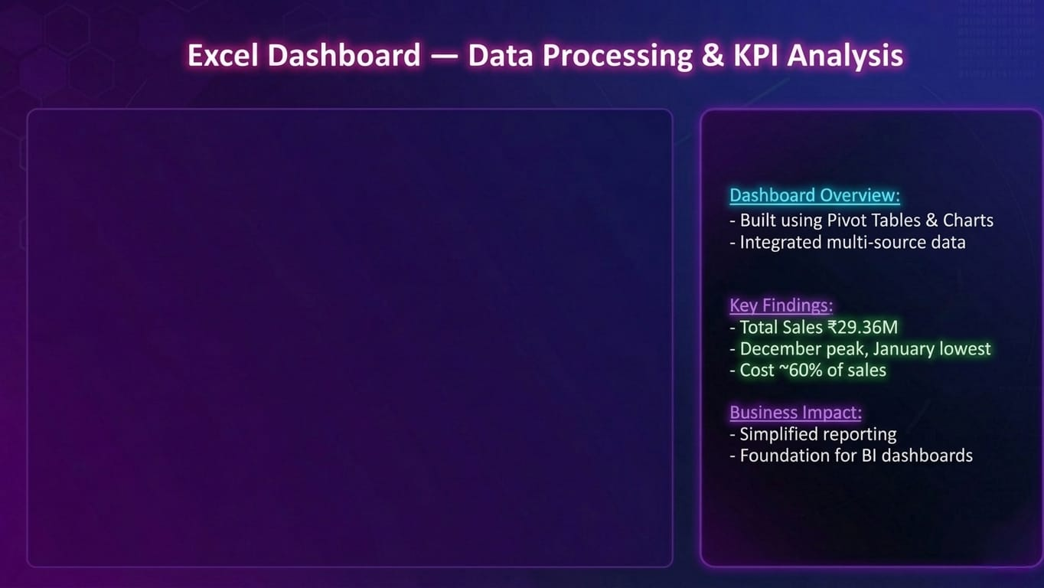
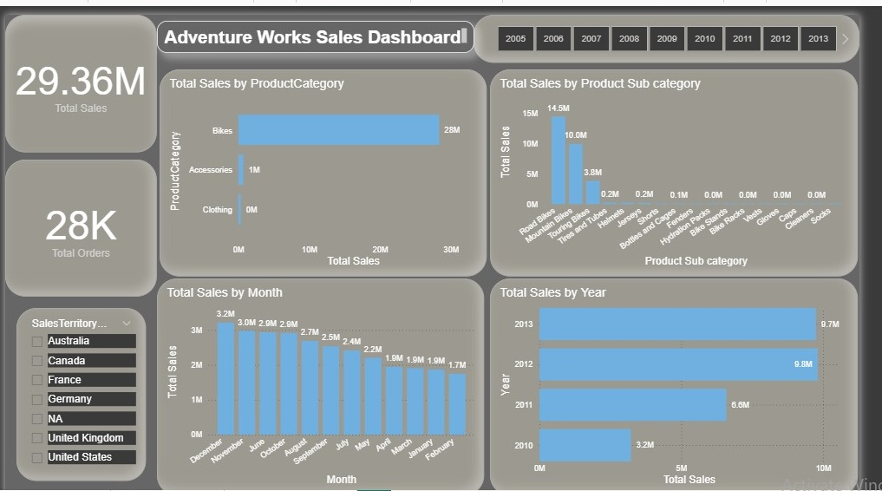

Slide 11
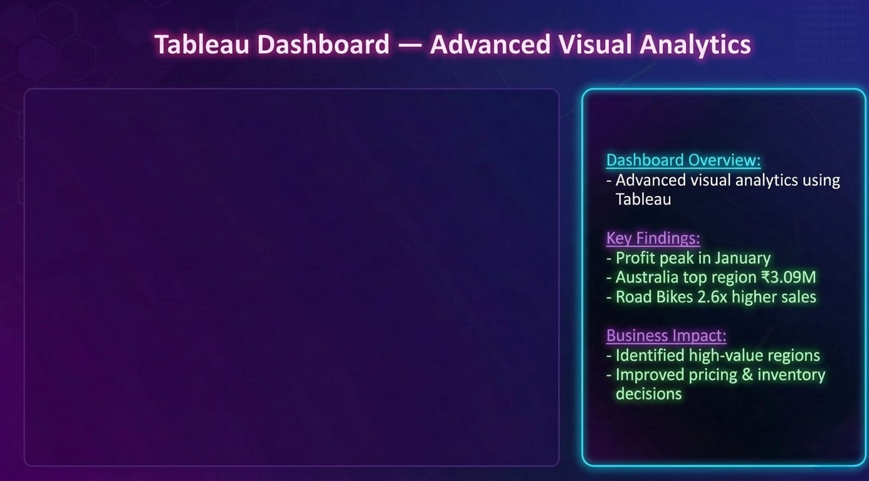
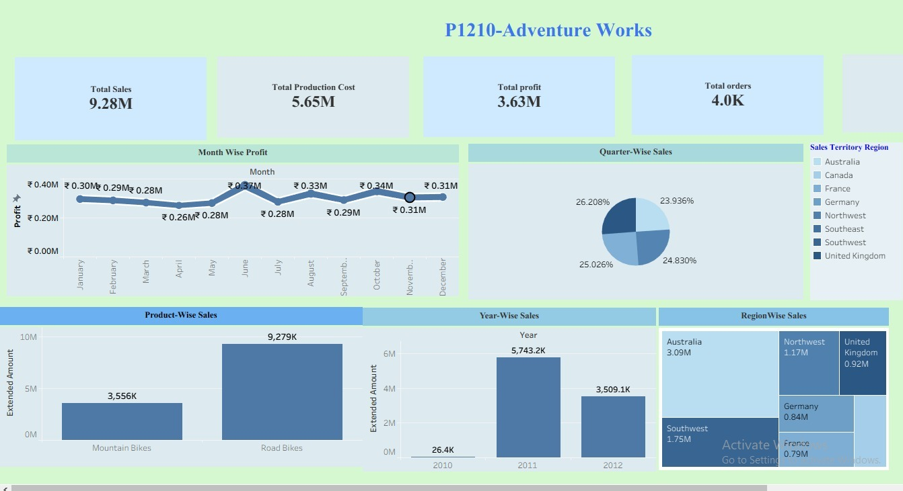

Slide 12
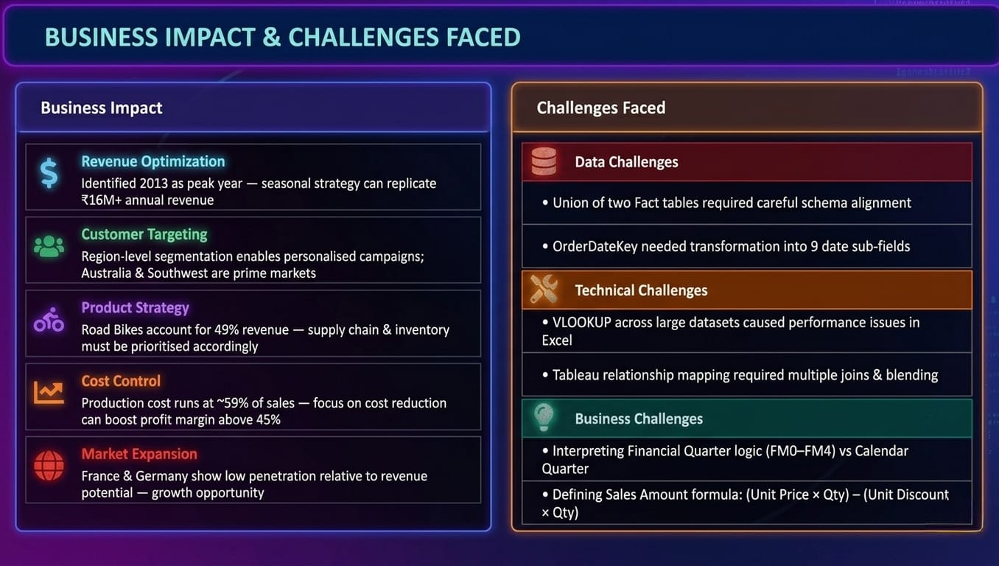

Slide 13
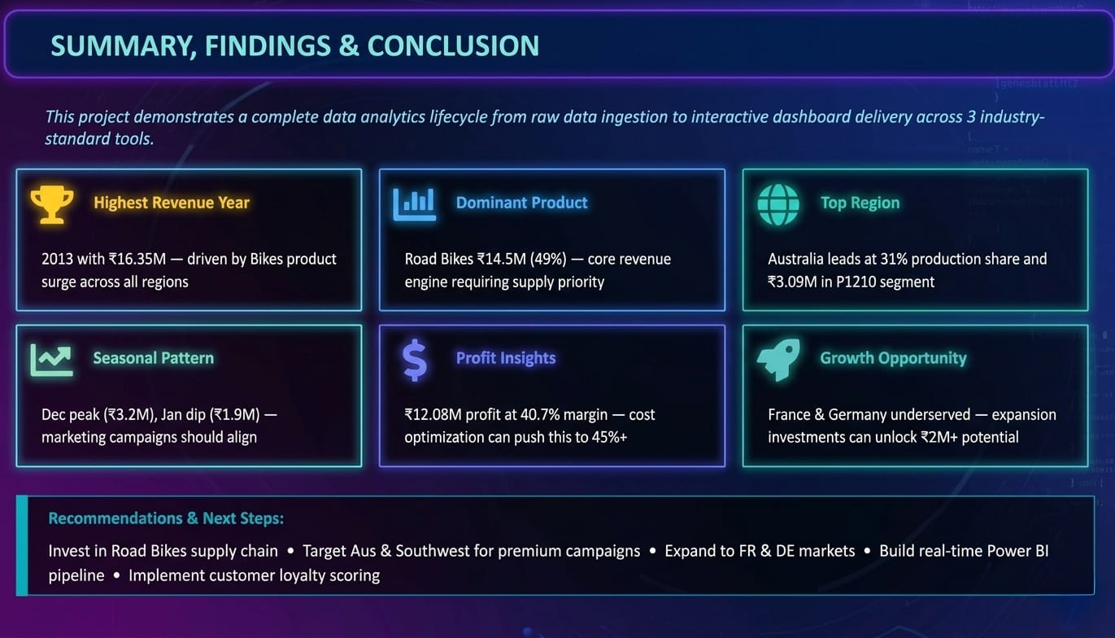

Slide 14
Thank you…
BY GROUP 1

